Slide 1




Session 17
SQL Server 2016
New Features of SQL Server 2016

Slide 2
Objectives
SQL Server
2016
List new features of SQL Server 2016
Explain Real-time Operational Analytics
Describe native JSON support
Explain AlwaysOn feature
Describe enhancements made to In-Memory OLTP (Hekaton)
© Aptech Ltd.
SQL Server Inside Out/ Session 17
2

Slide 3
New Features of SQL Server 2016
SQL Server 2016
Always Encrypted Stretch Database
Real-time Operational Analytics PolyBase with SQL Server Native JSON Support
Support for in-database analytics with R-integration Query Store
Dynamic Data
Masking
© Aptech Ltd.
SQL Server Inside Out/ Session 17
3

Slide 4
Enhancements in SQL Server 2016
SQL Server
2016
Enhancements to In-Memory OLTP
Enhancements to AlwaysOn
Row level Security Enhancements
Enhancements in T-SQL
© Aptech Ltd.
SQL Server Inside Out/ Session 17
4

Slide 5
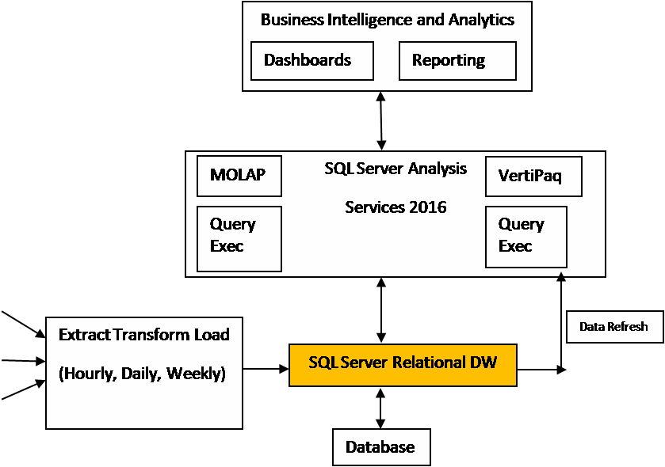
Conventional Methods of Data
SQL Server
2016
Modeling 1-2
The conventional methods of data modeling are as follows:
Multidimensional Online Analytical Processing (MOLAP) with pre-collected data
Tabular model with data in the database with regular Extract, Transform,
and Load (ETL)
A typical deployment wherein SQL Server is used for relational Data Warehouse and SQL Server Analysis Services (SSAS) for data modeling
© Aptech Ltd.
SQL Server Inside Out/ Session 17
5

Slide 6
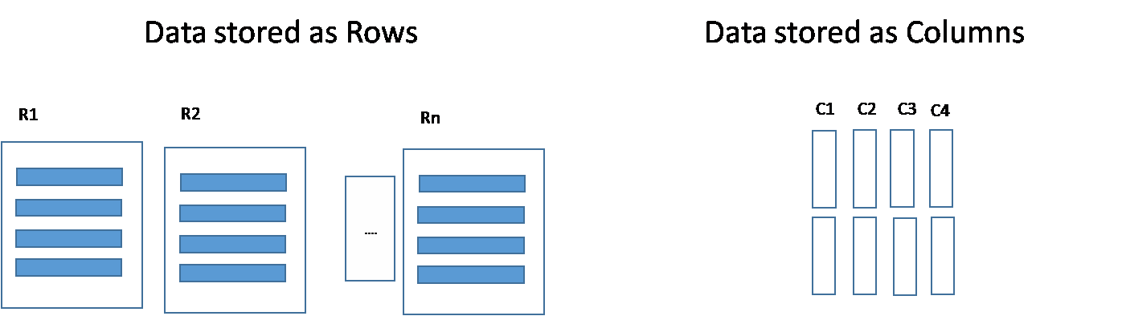
Conventional Methods of Data
SQL Server
2016
Modeling 2-2
Following are some challenges in this method:
Cube Processing: Requires Periodic refreshing and aggregation of data
Data Latency: Latest data fetched is from previous refresh cycle and is highly unacceptable
Very Large Database Support: Loading data to separate Business
Intelligence (BI) servers may not always be a feasible solution
Clustered Columnstore Index (CCI) addresses some of these drawbacks.
Storage of
Data
as Rows and as Columns
© Aptech Ltd.
SQL Server Inside Out/ Session 17
6

Slide 7
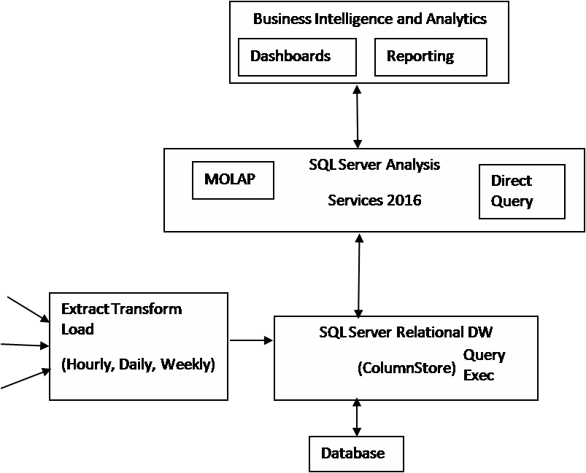
Recommended Configuration
SQL Server
2016
Columnstore indexes eliminate the need to pre-collect data for report queries. Recommended configuration is shown in the following figure:
© Aptech Ltd.
SQL Server Inside Out/ Session 17
7

Slide 8
Real Time Operational Analytics 1-2
SQL Server
2016
Data and analytics help businesses to take decisions more efficiently.
The evolution of social media and Internet of Things (IOT) has contributed to enormous growth of data.
Power Pivot is one of the tools used to access such huge data sets.
Power Pivot is not adequate for some of the needs.
Queries also
Increase in the number of queries
More employees have access to the data sets
tend to become ad-hoc rather than simple
Degrades analytics query performance
SQL Server 2016 takes care of these challenges with the improvements to In-Memory analytics
© Aptech Ltd.
SQL Server Inside Out/ Session 17
8

Slide 9
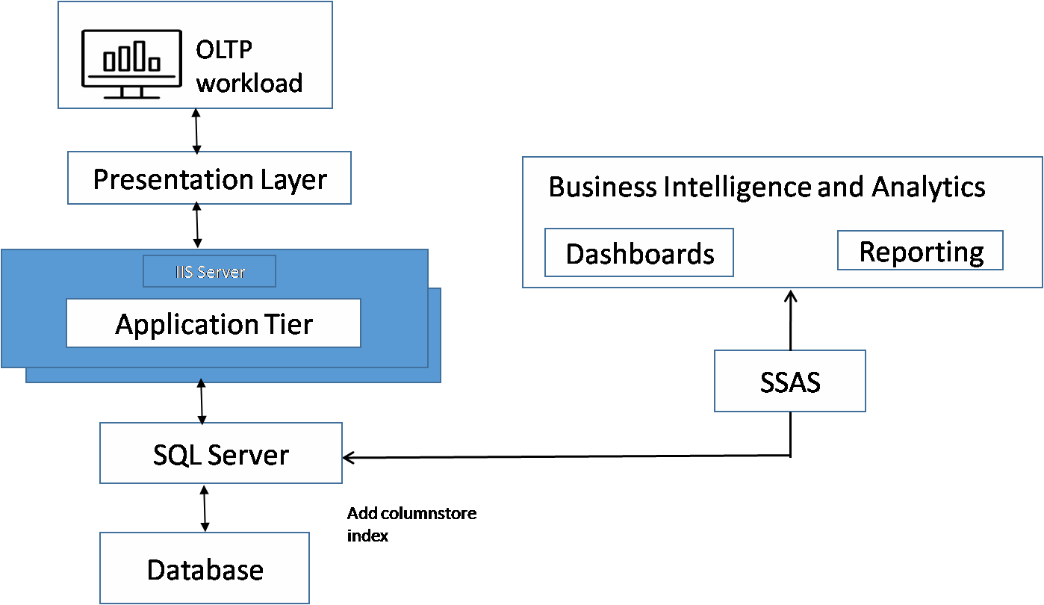
Real Time Operational Analytics 2-2
SQL Server
2016
Real Time Operational Analytics enables users to run analytics queries directly on operational workload using columnstore indexes. One possible configuration to run Analytics queries is:
© Aptech Ltd.
SQL Server Inside Out/ Session 17
9

Slide 10
Steps to Perform Real Time
SQL Server
2016
Operational Analytics
Identify the table(s) and the columns required to run analytics
Create columnstore indexes for those tables
Set up Analytics framework to fetch data directly from Operational Workload

Slide 11
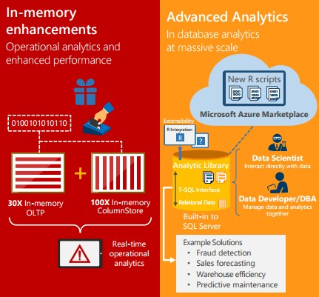
In-memory Enhancements and
SQL Server
2016
Advanced Analytics
Figure shows the representation of In-memory enhancements and
Advanced Analytics.

Slide 12
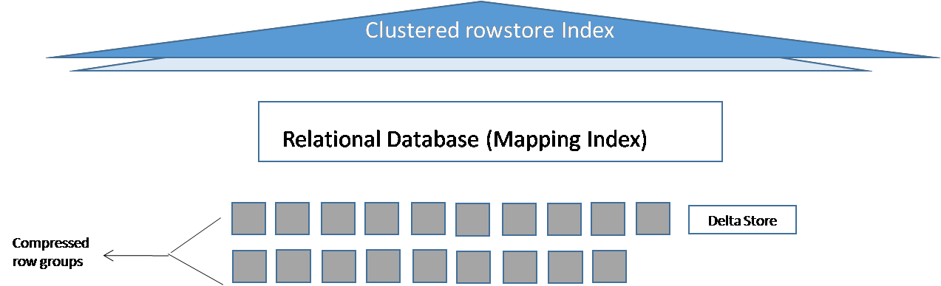
NonClustered Columnstore Index
SQL Server 2016
Standard configuration requires:
Separate Data Warehouse for Data analytics
Data collected from multiple sources Hence, SQL Server 2016 provides:
Updateable NonClustered Columnstore Index (NCCI)
Real time analytics on operational schema
Existing OLTP need not be changed
Single NCCI can replace other OLTP workload indexes
Following figure shows a table with NCCI:

Slide 13
Challenges with NCCI Configuration
SQL Server
2016
and Solution
Performance of analytics queries
Normalized schema for OLTP databases
Normalization might involve complex joins
between many tables
Using the same OLTP database might lead to very poor performance
Challenges
Use of NCCI which can execute many analytics queries in few seconds
A dedicated Data Warehouse could improve the
performance of analytics query
Solution
Reduce impact on operational workload
Filtered Columnstore Index
Compression Delay
Offloading Analytics Queries to Readable Secondary
Overall, it is a trade-off between real time operational analytics and its impact
on operational workload

Slide 14
Native JSON Support
SQL Server
2016
JavaScript Object Notation (JSON)
SQL Server 2016
A subset of JavaScript programming language
Language-independent,
lightweight
Provides a human readable text data exchange format
Native support for JSON data
Supports JSON data with
its NVARCHAR data type
The NVARCHAR data type provides more flexibility
Developers can concentrate on application logic than having to write functions to parse JSON data

Slide 15
Exporting Tabular Data as JSON
SQL Server
2016
Data 1-5
Following are the clauses to export tabular data as JSON data:
The FOR JSON [AUTO|PATH] clause
Use this clause in SQL queries to fetch data in JSON format
The FOR JSON AUTO clause
SQL Server 2016 automatically formats the nested JSON sub
arrays of query result

Slide 16
Exporting Tabular Data as JSON
SQL Server
2016
Data 2-5
Example 1:
Using FOR JSON AUTO Clause:
CREATE TABLE
Employees (
ID INT IDENTITY (1,1) NOT NULL,
FirstName VARCHAR (255),
LastName VARCHAR (255),
Grade INT,
Age DECIMAL (3,1)
)
Create table Employees
Insert some data
Table is
created
INSERT INTO Employees (FirstName, LastName, Grade, Age) SELECT 'Mark', 'Thomas', 2, 45 UNION ALL
SELECT 'Salmon', 'John', 1, 56 UNION ALL
SELECT 'Kirsten', 'Powell', 3, 28
Rows are inserted

Slide 17
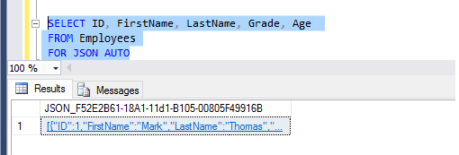
Exporting Tabular Data as JSON
SQL Server
2016
Data 3-5
Example 1 (Continued):
Using FOR JSON AUTO Clause:
Create SQL Query to retrieve table data using FOR JSON AUTO clause
The Query and its outcome in the SSMS
With the FOR JSON AUTO clause, SQL Server automatically formats the JSON output based on the query structure

Slide 18
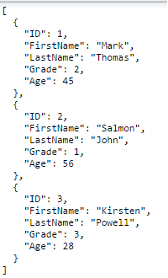
Exporting Tabular Data as JSON
SQL Server
2016
Data 4-5
Example 1 (Continued):
Using FOR JSON AUTO Clause:
Copy the JSON data to a text editor such as Notepad and
format it
The output is viewed as

Slide 19
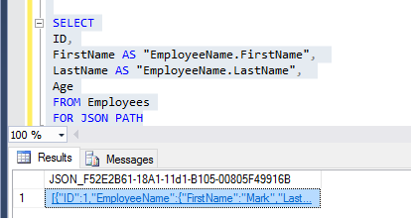
Exporting Tabular Data as JSON
SQL Server
2016
Data 5-5
Example 2:
Using FOR JSON PATH Clause:
The SQL Query and its JSON output in the SSMS for the Employees table that is already created
In this SELECT query, SQL Server obtains the result of the query and formats it in the output as a JSON document.

Slide 20
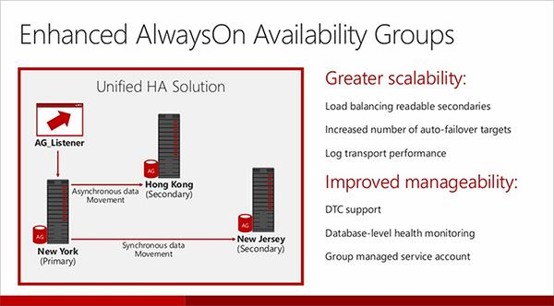

AlwaysOn
SQL Server
2016
AlwaysOn is a feature that was first introduced in SQL Server 2012
A substitute for data mirroring
High-availability and disaster recovery solutions for mission-critical applications
Requires a WSFC cluster for deployment
Major enhancements to AlwaysOn in SQL Server 2016 are:
Scalability: Achieved through load balancing readable secondaries
Manageability: Availability Group health monitors even the database health
Pictorial representation of Enhanced AlwaysOn Availability Groups

Slide 21
Availability Group
SQL Server
2016
An Availability group
Supports failover environment for primary and secondary
databases
An availability replica
Hosts each set of Availability database.
Two types
Primary replica for the
primary databases
One to eight secondary
replicas for a set of
secondary databases

Slide 22
Availability Databases
SQL Server
2016
The database:
Should be Online, read-write database
Reside on the server instance
Will be the primary database
Can be accessed by clients
Secondary databases are created, after restoring the backups of
the new primary database

Slide 23
Availability Replicas
SQL Server
2016
Availability Replicas are:
Set of two or more failover patterns
Defined by each availability group
Hosted for each availability group
A role is assigned for each Availability replica

Slide 24


Availability Modes
SQL Server
2016
An availability replica has a property called availability mode. Following are the two availability modes:
Asynchronous-commit mode
Reduced transaction latency on secondary databases
Secondary databases are not in sync
with primary database
Chances of some data loss
Asynchronous-commit replica uses this mode
Synchronous-commit mode
Completely protected
Secondary and primary databases
are always in sync
Increase in transaction latency
Synchronous-commit replica uses this mode

Slide 25
Types of Failover
SQL Server
2016
Three types: Automatic, Manual, and Forced
The availability mode of the secondary replica determines which failover type it
supports from the following given options:
The synchronous- commit mode | Planned manual failover (without data loss) | Automatic failover (without data loss) | The asynchronous- commit mode
Supports two failover types: Automatic failover Planned manual failover | Issued by the database administrator Causes the secondary replica to change to primary replica and vice versa | Any failure causing the secondary replica to change to primary replica Changes to secondary replica once the original primary replica is available | Supports only forced manual failover There might be data loss

Slide 26
Active Secondary Replicas
SQL Server
2016
Active secondary replicas are supported by AlwaysOn availability groups. The functionalities provided by Active secondary replicas are:
Backup operations on secondary replicas
Readable secondary replicas

Slide 27



Session-Timeout Period
SQL Server
2016
The session-timeout property ensures that no two replicas wait for each other indefinitely
Default value 10 seconds
Minimum value 5 seconds
Recommended value 10 seconds or more

Slide 28
Automatic Page Repair
SQL Server
2016
The Availability replica takes care of automatic page repair of corrupted pages residing on a local database
A fresh copy of the page by the primary replica is taken, if
the secondary replica fails to read the corrupted page
The first response by all secondary replicas is taken, if the primary replica fails to read the corrupted page
The corrupt page is replaced with the fresh copy provided the request succeeds

Slide 29
Enhanced Features in SQL Server 2016
SQL Server
2016
Enhanced AlwaysOn
Enhanced Online Operations
Scalability
Hardware Acceleration for TDE Encryption/Decryption
Buffer Pool Extension
In-Memory OLTP (Hekaton) and Optimization Enhancements
Key changes to In-Memory OLTP are as follows:
Enhanced In-Memory performance
Maximum memory for memory-optimized tables
Collation
Schema and data changes
More Transact-SQL features supported
Parallel Plans
Transparent data encryption
AlwaysOn
Number of sockets

Slide 30
Summary
SQL Server
2016
SQL Server 2016
New powerful features
Real-time operational analytics
Native JSON support
Stretch database
Always Encrypted
Enhancements to existing features
AlwaysOn
In-Memory OLTP (Hekaton)
Optimization enhancements
Real-time Operational Analytics: users can run analytics queries directly
on operational workload
Native support for JSON

